Slide 1
Security Background 1
32153290 이승균

Slide 2
Security Background
The attacks that can be performed on a computer system are broadly classiﬁed into physical attacks and software attacks.
Physical attack : Attacker takes advantage of a system’s physical implementation details to perform an operation that bypasses the limitations set by the computer system’s software abstraction layers.
Software attack : software attacks are performed solely by executing software on the victim computer.
3.1 Cryptographic Primitives (7p)

Slide 3
Cryptographic Primitives (3.1)
Cryptographic primitives that guarantee conﬁdentiality, integrity, and freshness.
Conﬁdentiality : A message whose conﬁdentiality is protected can be transmitted over an insecure medium without an adversary being able to obtain the information in the message.
Integrity : The receiver is guaranteed to either obtain a message that was transmitted by the sender, or to notice that an attacker tampered with the message’s content.
Freshness : A freshness guarantee assures the receiver that she will obtain the latest message coming from the sender, or will notice an attack.

Slide 4
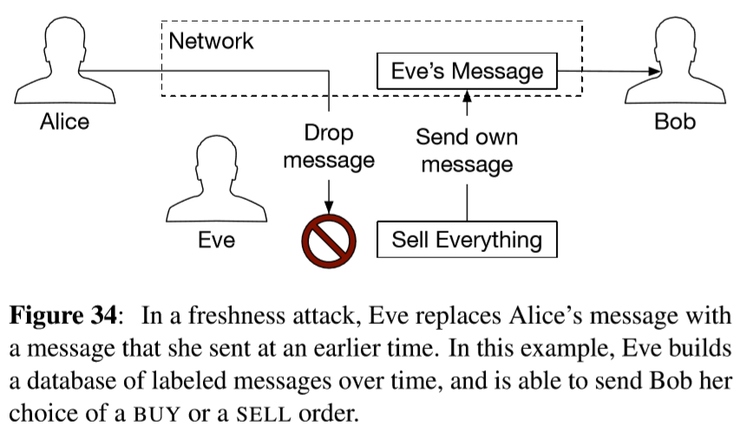


Cryptographic Primitives (3.1)
A freshness guarantee is stronger than the equivalent integrity guarantee.
The latter does not protect against replay attacks where the attacker replaces a newer message with an older message coming from the same sender.

Slide 5
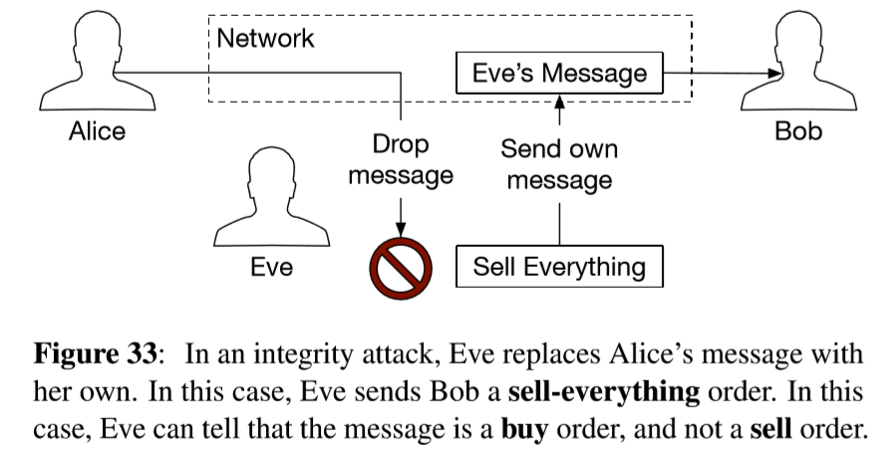
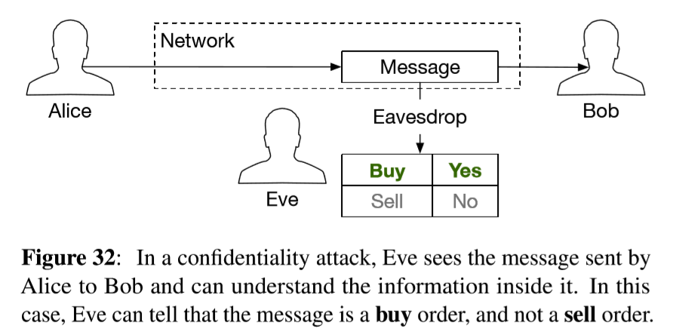

Cryptographic Primitives (3.1)

Slide 6
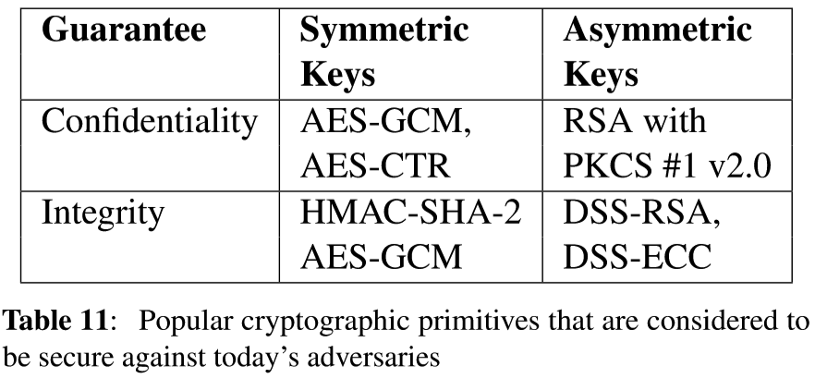
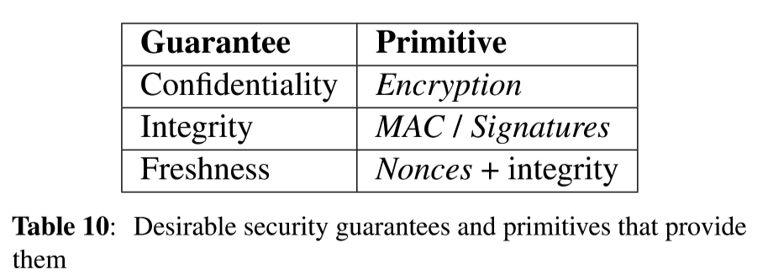
Cryptographic Primitives (3.1)
Cryptographic primitives that guarantee conﬁdentiality, integrity, and freshness.

Slide 7
Cryptographic Keys(3.1.1)
All cryptographic primitives rely on keys, which are small pieces of information that must only be disclosed according to speciﬁc rules.
Each cryptographic primitive has an associated key generation algorithm that uses random data to produce a unique key.
The random data is produced by a cryptographically strong pseudo-random number generator (CSPRNG)that expands a small amount of random seed data into a much larger amount of data.

Slide 8
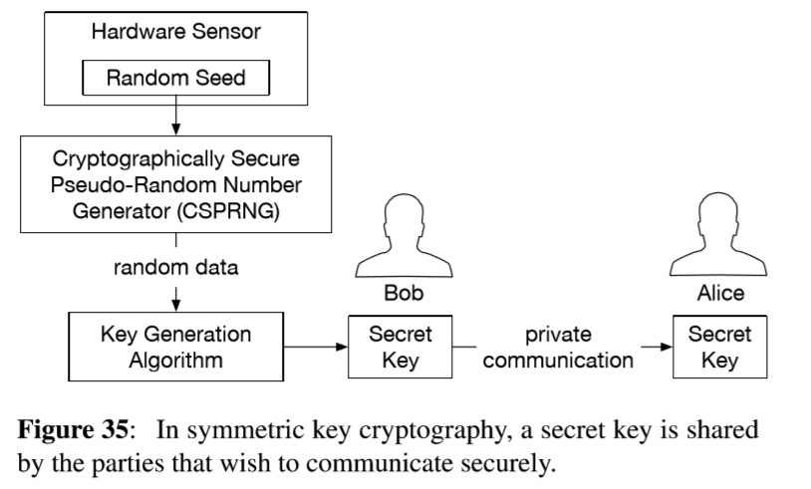
Cryptographic Keys(3.1.1)
Symmetric key cryptography requires that all the parties in the system establish a shared secret key, which is usually referred to as “the key”.
Typically, one party executes the key generation algorithm and securely transmits the resulting key to the other parties.

Slide 9
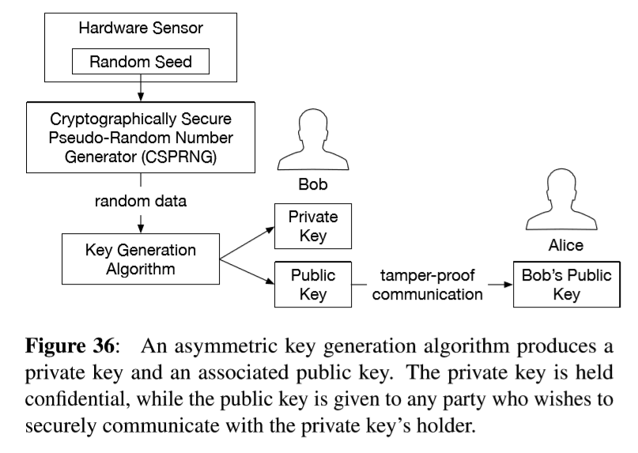
Cryptographic Keys(3.1.1)
Asymmetric key cryptography does not require a private channel for key distribution.
Each party executes the key generation algorithm, which produces a private key and a public key that are mathematically related.
Each party’s public key is distributed to the other parties over a channel with integrity guarantees.
Asymmetric key primitives are more ﬂexible than their symmetric counterparts, but are more complicated and consume more computational resources.

Slide 10
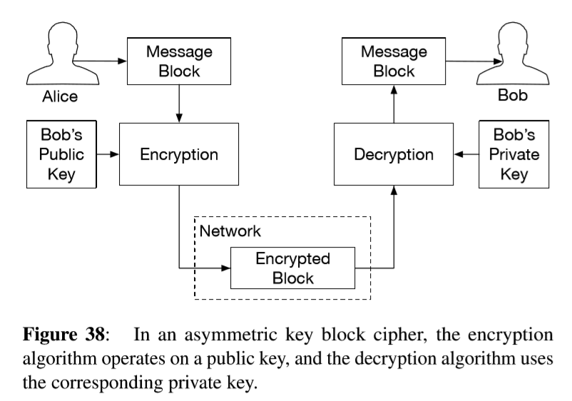
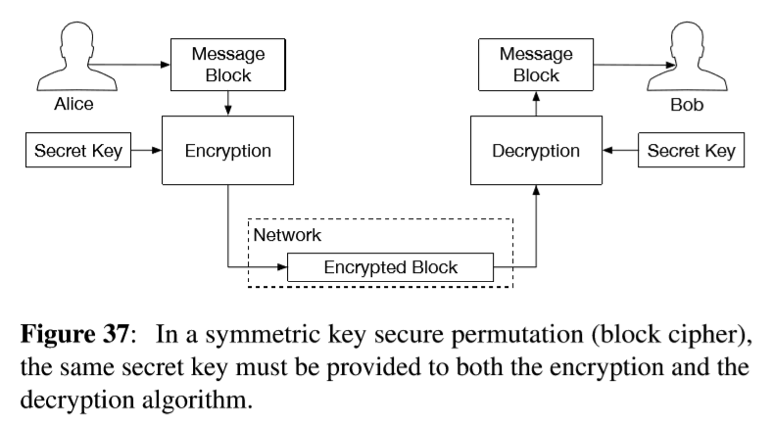
Confidentiality(3.1.2)
Many cryptosystems that provide integrity guarantees are built upon block ciphers that operate on ﬁxed-size message blocks.
Symmetric key encryption algorithms use the same secret key for encryption and decryption.
Asymmetric key block ciphers use the public key for encryption, and the corresponding private key for decryption.

Slide 11
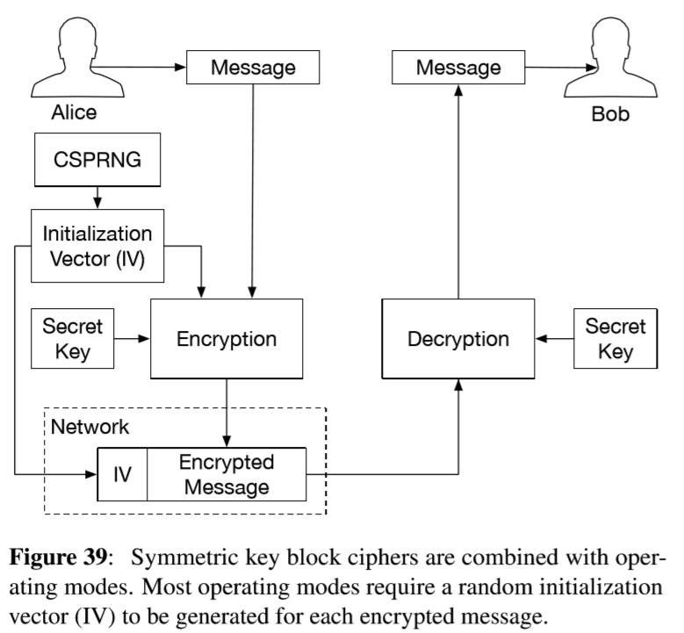
Confidentiality(3.1.2)
A block cipher would generate the same encrypted output for any of Alice’s BUY orders, as they all have the same content.
Symmetric key block ciphers are combined with operating modes to form symmetric encryption schemes.
Most operating modes require a random initialization vector (IV) to be used for each message.

Slide 12
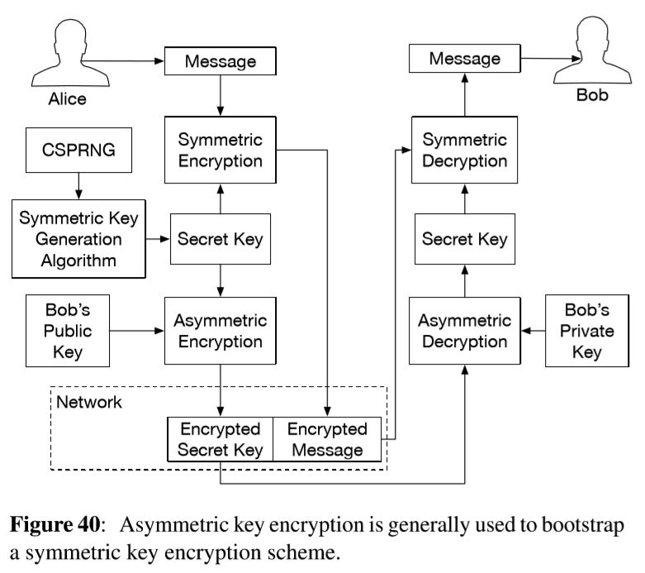
Confidentiality(3.1.2)
In the asymmetric key setting, there is no concept equivalent to operating modes.
Each block cipher has its own assumptions, and requires a specialized scheme for general-purpose usage.
Asymmetric encryption algorithms have much higher computational requirements than symmetric encryption algorithms.
Therefore, when non-trivial quantities of data is encrypted, the sender generates a single-use secret key that is used to encrypt the data, and encrypts the secret key with the receiver’s public key.

Slide 13
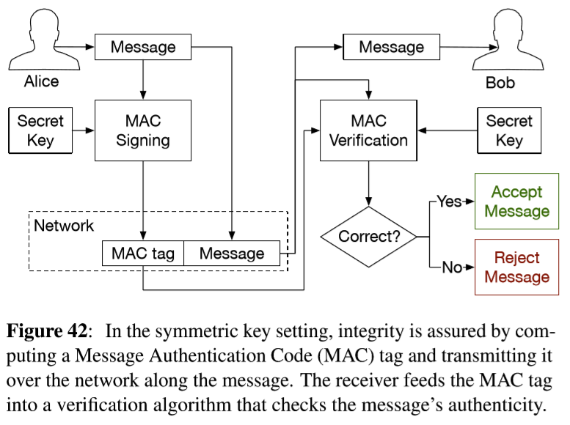
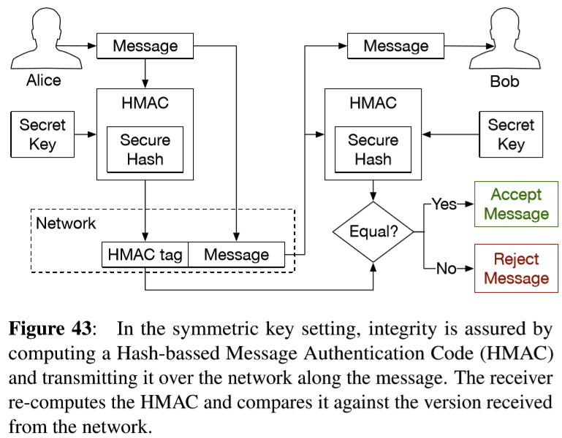
Integrity(3.1.3)
In the symmetric key setting, integrity guarantees are obtained using a Message Authentication Code(MAC) cryptosystem.
The sender uses a MAC algorithm that reads in a symmetric key and a variable-length message, and produces a ﬁxed-length, short MAC tag.
The receiver provides the original message, the symmetric key, and the MAC tag to a MAC veriﬁcation algorithm that checks the authenticity of the message.
The key property of MAC cryptosystems is that an adversary cannot produce a MAC tag that will validate a message without the secret key.

Slide 14
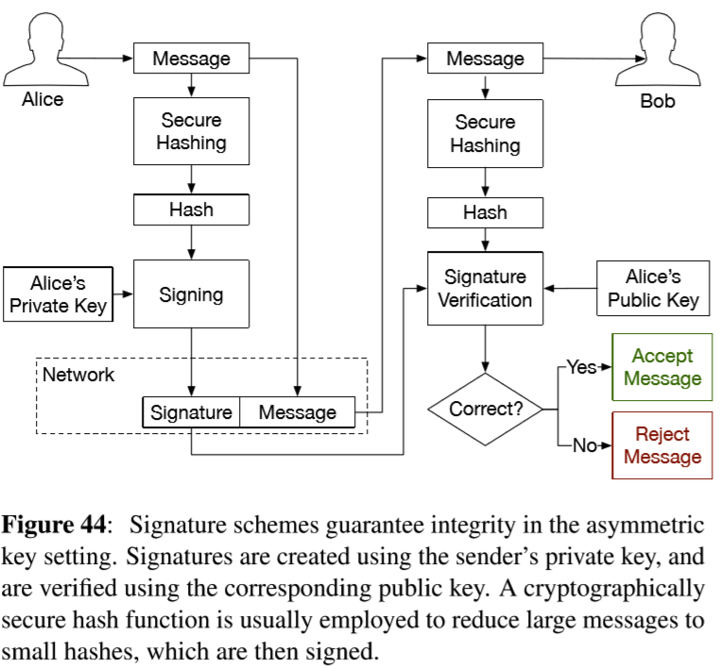
Integrity(3.1.3)
Asymmetric key primitives that provide integrity guarantees are known as signatures.
The message sender provides her private key to assigning algorithm, and transmits the output signature along with the message.
The message receiver feeds the sender’s public key and the signature to a signature veriﬁcation algorithm, which returns TRUE if the message matches the signature, and FALSE if the message has been tampered with.
Signing algorithms can only operate on small messages and are computationally expensive.

Slide 15
Freshness(3.1.4)
Freshness guarantees are typically built on top of a system that already offers integrity guarantees, by adding a unique piece of information to each message.
The main challenge in freshness schemes comes down to economically maintaining the state needed to generate the unique pieces of information on the sender side, and verify their uniqueness on the receiver side.
A popular solution for gaining freshness guarantees relies on nonces, single-use random numbers.
Nonces are attractive because the sender does not need to maintain any state ; the receiver, however, must store the nonces of all received messages.
Nonces are often combined with a message timestamping and expiration scheme.

Slide 16
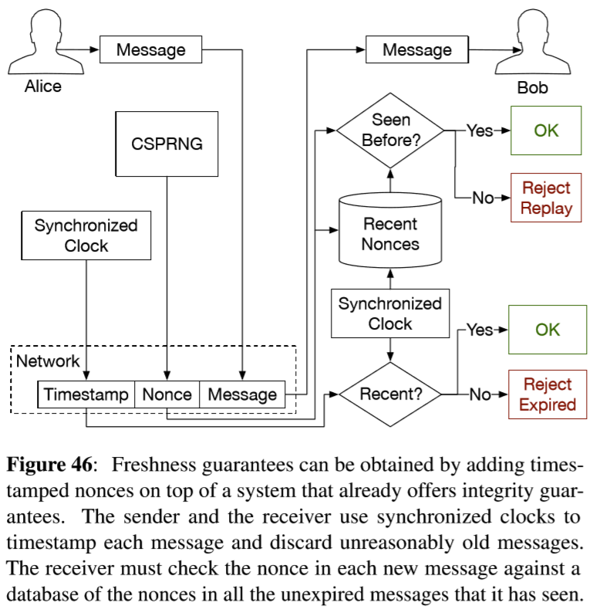

Freshness(3.1.4)
An expiration can greatly reduce the receiver’s storage requirement, as the nonces for expired messages can be safely discarded.
However, the scheme depends on the sender and receiver having synchronized clocks.

Slide 17
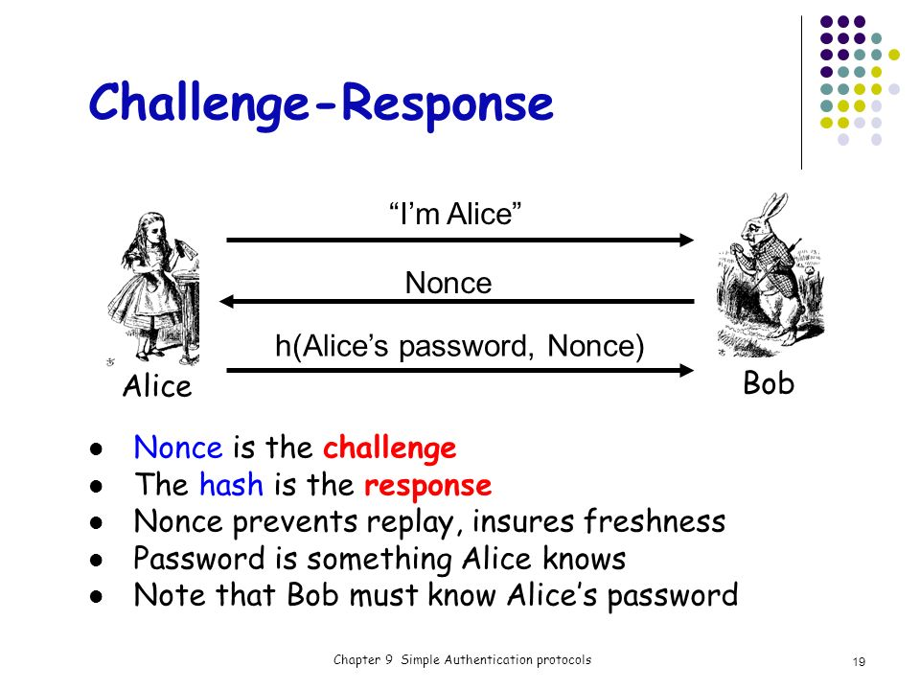
Freshness(3.1.4)
Alternatively, nonces can be used in challenge response protocols, in a manner that removes the storage overhead concerns.
The challenger generates a nonce and embeds it in the challenge message.
The response to the challenge includes an acknowledgement of the embedded nonce.
The nonce is only stored by the challenger, and is small in comparison to the rest of the state needed to validate the response.

Slide 18
Next week
3.2 Cryptographic Constructs (3p)
3.3 Software Attestation Overview (2p)

